Slide 1
Big Data Administration
including ambari

Slide 2
Topics
Problems with traditional large-scale computing systems
Motivation for Hadoop
Fundamental Hadoop concepts
Hadoop Clusters
Core components of Hadoop
HDFS
MapReduce
YARN
Hadoop Ecosystem
HBase

Slide 3
Big Data
Velocity
Variety
Volume
Speed of new data arriving
Types of data
Amount of data

Slide 4
Volume
Google processes over 24 petabytes of data a day
There are over 86 million WordPress websites
More than 1.5 billion shares are traded on the New York Stock Exchange every day
Facebook users create 2.7 billion comments and likes every day

Slide 5
Velocity
Processes are increasingly autonomous
Systems are increasingly interconnected
People are increasingly interacting online

Slide 6
Variety
Different kinds of data
Social network connections
Log files
Electronic records
Images
Audio
Video
Ratings and reviews
Email
Text
Not necessarily well structured

Slide 7
Traditional large-scale computation
Bigger computers
More memory
Faster processor
High cost
Limited scalability
Moore’s law
Kryder’s law
Disk capacity
Disk read time
Year | Capacity (GB) | Cost per GB
1997 | 2.1 | $157
2004 | 200 | $1.05
2014 | 3000 | $0.036
Year | Capacity (GB) | Transfer Rate (MB/s) | Disk Read Time (minutes)
1997 | 2.1 | 16.6 | 2
2004 | 200 | 56.5 | 59
2014 | 3000 | 210 | 238

Slide 8
Scalability
Consider both storing the data and analyzing it
However all of this data is valuable!
Marketing analysis
Product recommendations
Demand forecasting
Fraud detection
If we don’t analyse all of it we risk missing some key information

Slide 9
Distributed systems
Typical processing pattern:
Copy input data from storage to compute node
Perform necessary processing
Copy output data back to storage
However this only really works for small amounts of data where the second step dominates the overall time taken
With larger amounts of data we risk spending more time copying it than processing it!

Slide 10
Distributed systems complexity
Availability
Data consistency
Event synchronization
Bandwidth
Failures
Scalability
Independent running jobs
Complex code

Slide 11

The Hadoop solution
Inspired by Google’s MapReduce and GFS architecture
Hadoop aims to solve the problems addressed in the previous slides
Nodes talk to each other as little as possible
Bring the computation to the data!
Data replication
Inexpensive hardware
Intelligent job scheduling

Slide 12
Data access bottleneck - solved
Store and process data on the same machine
Data locality
Bring the computation to the data
Conserves bandwidth

Slide 13
Disk performance - solved
Use multiple disks in parallel
One disk might have a transfer rate of 210 MB/s
4 hours to read 3TB of data
1000 of those disks can transfer 210 GB/s
15 seconds to read 3TB of data
Collate the storage and processing

Slide 14
Scalability - solved
Simply add more nodes to the cluster to increase scale as needed
We’ll see how to add nodes in future lectures
Inexpensive hardware makes this less costly
Increasing the workload only results in a graceful decline in performance, not immediate failure

Slide 15
Fault tolerance - solved
With Hadoop we accept that failure is inevitable
Instead of minimizing the possibility of failure, aim to minimize the effect of failure
Data replication across nodes so that if one node fails, the data can be re-replicated from one of the other copies
Data processing is broken into small tasks so many tasks run in parallel
If one node fails during processing, the small task can be rescheduled elsewhere
Nodes that recover can rejoin the system automatically

Slide 16
Hadoop core components
Hadoop Distributed File System (HDFS)
Yet Another Resource Negotiator (YARN)
MapReduce

Slide 17
Apache Ambari

Slide 18
Ambari Server
The collection point for data from across the cluster
Relies on a database that maintains cluster topology, configuration information, and user and group information
Cluster nodes have Ambari Agent enabling the server to monitor and control
Web UI at <server_host_ip>:8080

Slide 19
Users and groups
Ambari vs Hadoop
Ambari user privileges set up in web portal with log ins, stored in database
Hadoop users can be stored in database or Linux /etc/passwd file
Different parts of Hadoop may have different permissions
Hadoop services are run under the ownership of a particular Linux account

Slide 20
Ambari users and groups
Permission type | Privileges
No permissions (default) | Log in permitted, but no access to info
Read only | Log in, can view services and configurations but cannot modify
Operator | Log in, may start, restart, stop, and add new services, can modify or revert configurations
Admin | Log in, full permissions for services and configurations, can manage user and group accounts and change permissions
You can also create Ambari Views, a custom tool to provide a certain view of the cluster, to which certain users or groups may be assigned access

Slide 21
Ambari admin
Select ‘Manage Ambari’ on the admin drop down menu to manage users, groups, and permissions
Users
Active/Inactive means whether they can log in
Groups
Add users to groups on the group page
Permissions page to assign permissions to users and groups
Permissions are additive, that is, a user assigned read only permission who belongs to an operator group will have operator privileges
Notes:
TASK 3

Slide 22
Hadoop Configuration Files
core-site.xml – core configuration used by a variety of components
hdfs-site.xml – HDFS configuration mostly used by NameNodes/DataNodes
yarn-site.xml – YARN configuration used by resource management
mapred-site.xml – MapReduce configuration
hadoop-env.sh – bash script file of environment variables used by various scripts and programs
log4j.properties – Java system log file configuration
hadoop-metrics2.properties – Java metrics publishing configuration

Slide 23
Hadoop Configuration Files
There are default files of each
You can have different ones across a cluster for different groups which you can manage via Ambari
Users can override settings when submitting a job
yarn jar –D property=value…

Slide 24
Hadoop Configuration Files
If you don’t want a user to be able to override a property you can mark it as final
Via the configuration file itself or Ambari
In Ambari simply click the lock button next to a value
In the file itself…
<property>
<name>dfs.datanode.data.dir</name>
<value>/hadoop/hdfs/data</value>
<final>true</final>
</property>

Slide 25
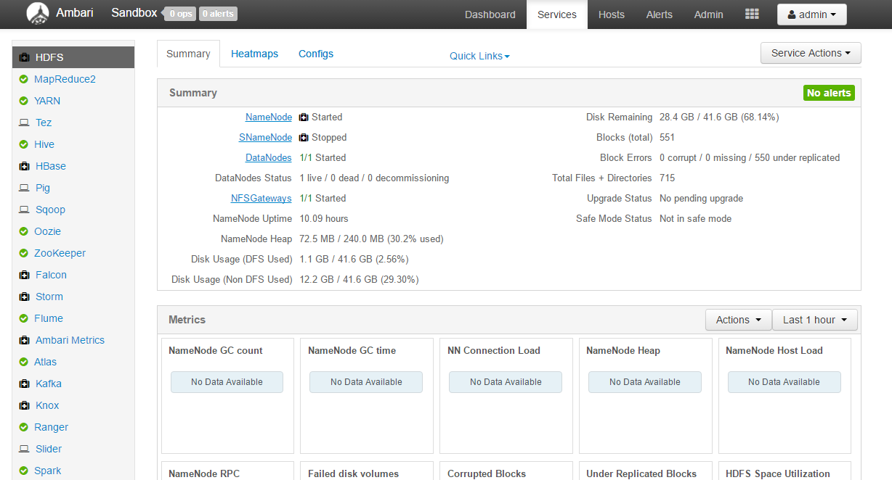
Notes:
Installed services on the left panel
Click any service to see information in the Summary tab
Heatmaps shows similar information on a node by node basis

Slide 26
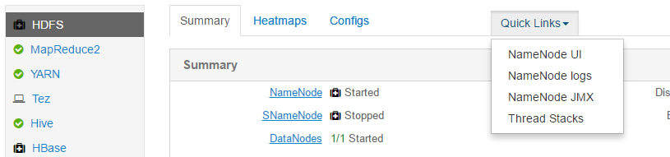
Many Hadoop services have their own Web UI. It’s worth remembering some of the ports you access frequently, but you can also use the quick links on the services summary page
The Web UIs tend to include information on how the service is running

Slide 27
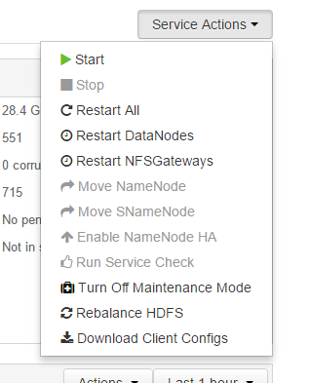
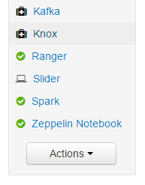
Actions
Service Actions will be different for each service you look at, allowing you to start or stop particular components of a service, or the entire thing
Actions are used for starting or stopping the entire cluster or installing new services

Slide 28
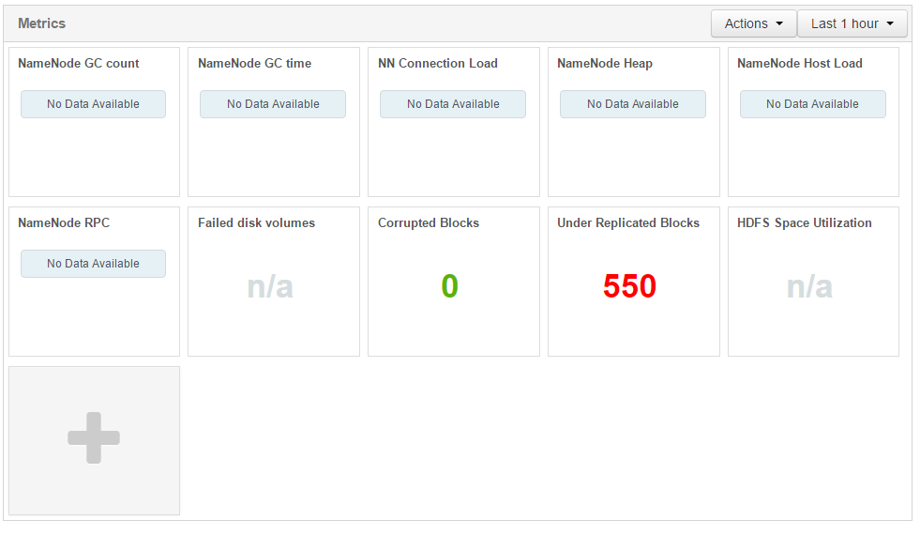
Notes:
Service specific metrics let’s us track interesting things about particular services. For example here we can see we have lots of under replicated blocks, so we should probably find the source of why we can’t re-replicate these (the answer is we’re working with the Hortonworks sandbox on only a single machine!)

Slide 29
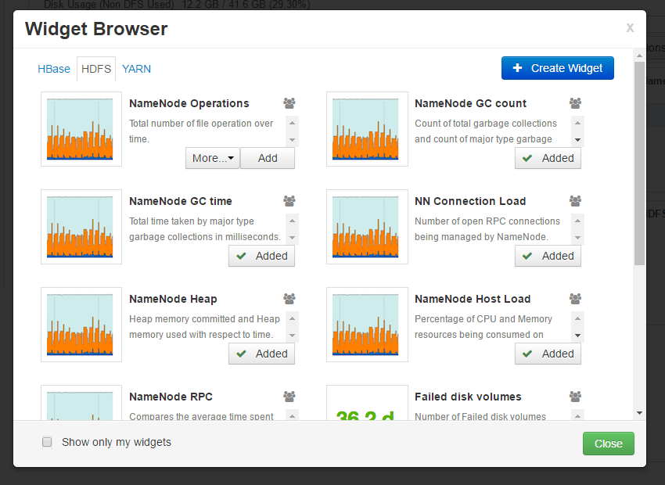
Notes:
You can add additional widgets for important things you need to know

Slide 30
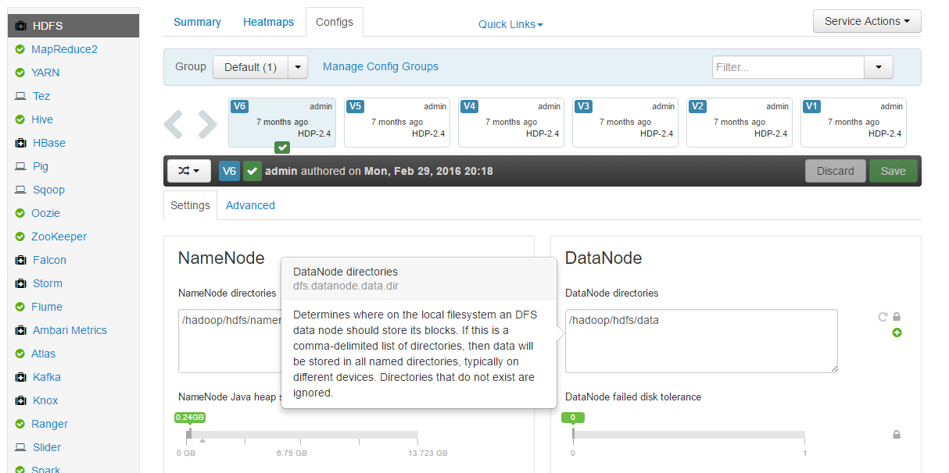
Notes:
In configs tab we can start looking at a range of configurations we can set
This can be done via sliders or typing in a value
The lock button will set to final
You can hover over any setting to find out more
You can revert
You can set to recommended value

Slide 31
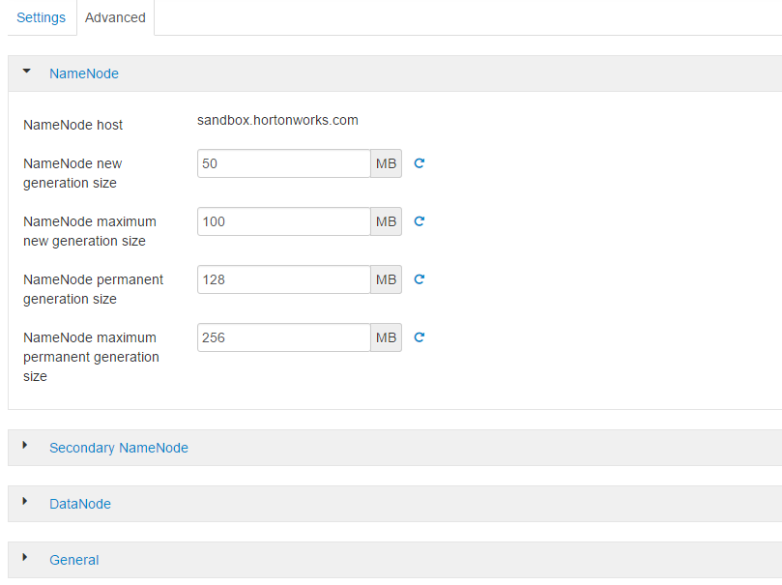
Notes:
There are lots more properties stored under ‘Advanced’
These tend to be grouped together somehow
The groups may not necessarily all change something in the same configuration file, just relating to the same daemon usually

Slide 32
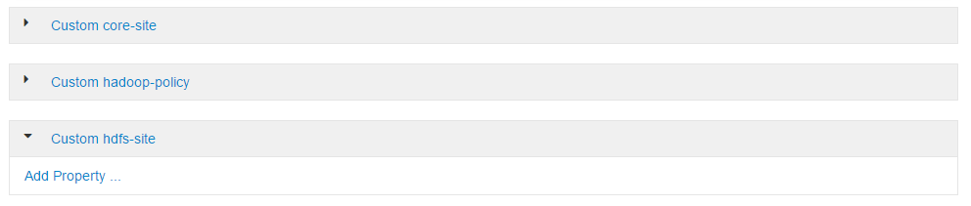
Notes:
Most services include custom sections for specific files where you can add more properties

Slide 33
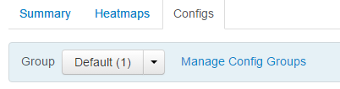
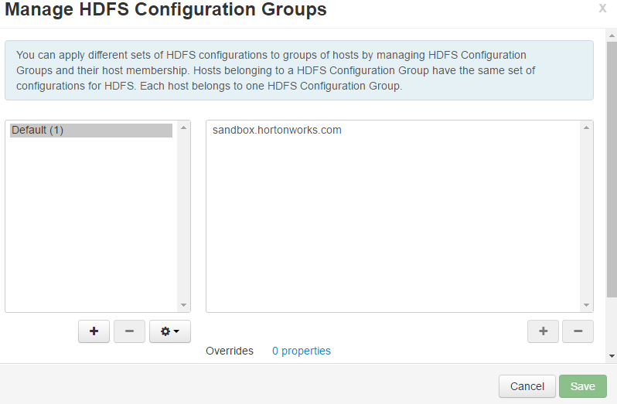
Configuration Groups
If the hardware is different in your cluster you may need to change your configuration dependent per machine

Slide 34
Client Configuration
Ambari can install client-side software and sort out client configuration files
Alternatively if software is manually installed then Ambari can download the client configuration files to it
An Ambari agent is not required just to download the configuration files but it is for the software

